Slide 1
Pediatric Chest X-ray Image Classification for Pneumonia Detection
Presented by: Karankumar Patel
Date: April 11th, 2024

Slide 2
Introduction
The objective is to develop an AI system that accurately classifies chest x-ray images into Pneumonia and Normal categories.
Chest X-ray images were taken from a group of kids aged one to five at Guangzhou Women and Children’s Medical Center in Guangzhou, China. These X-rays were taken during their regular hospital visits.
For the analysis of chest x-ray images, all chest radiographs were initially screened for quality control by removing all low quality or unreadable scans. The diagnoses for the images were then graded by two expert physicians before being cleared for training the AI system. In order to account for any grading errors, the evaluation set was also checked by a third expert.

Slide 3
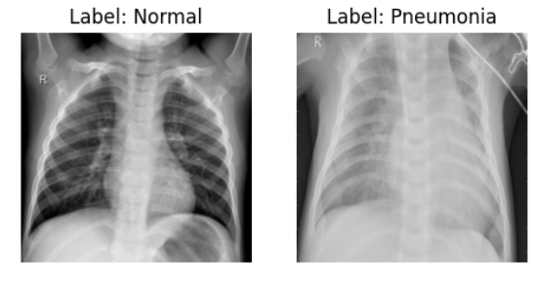
Data Collection & Preprocessing
Data Source: Kaggle
Total images across sets: 3,322 chest X-ray images, comprising 2,682 images in the training set, 624 in the validation set, and 16 in the test set.
Preprocessing Steps:
All images were resized to a uniform size of 224x224 pixels
to match the input size expected by ResNet model.
Then images were converted into tensors, a format suitable
for deep learning algorithms.
Pixel values were standardized across the three-color
channels using mean=[0.485, 0.456, 0.406] and
std=[0.229, 0.224, 0.225].

Slide 4
Model Training
Model: ResNet-18
Chose ResNet18 due to its state-of-the-art results in image classification and its suitability for my dataset. With fewer layers, it's less prone to overfitting, ensuring robust performance.
Loss function: Binary Cross Entropy with Logit
Optimizer: Stochastic Gradient Descent
Stochastic Gradient Descent (SGD) optimizer was selected with a learning rate of 0.001 to achieve rapid convergence and avoid overshooting, allowing the model to learn efficiently from the data.

Slide 5
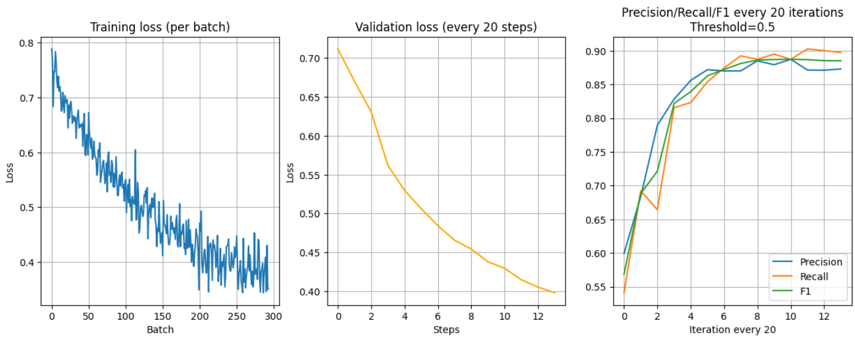
Model Evaluation
During training, the model achieved an accuracy of 89.30%, while during validation, it reached 85.42%. The training loss was 0.507, and the validation loss was 0.398. Additionally, the model achieved a precision of 87.28%, a recall of 89.74%, and an F1 score of 88.50%.

Slide 6
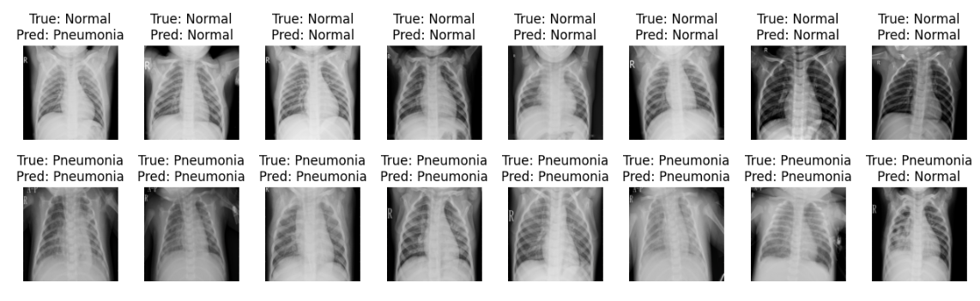
Evaluation on Test Data

Slide 7
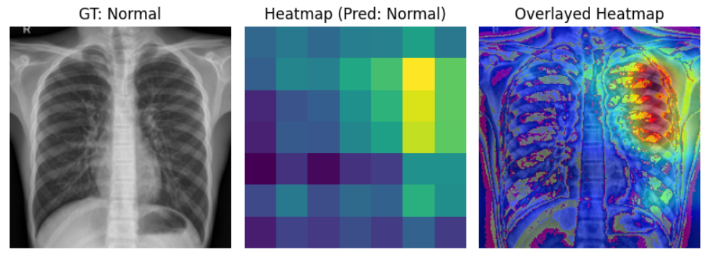
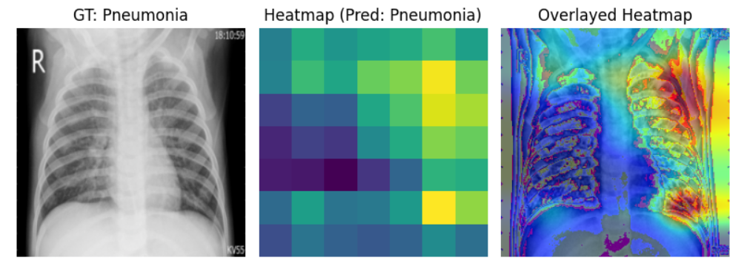
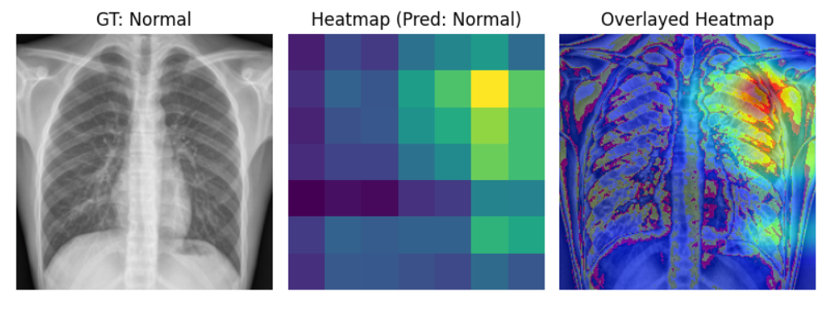
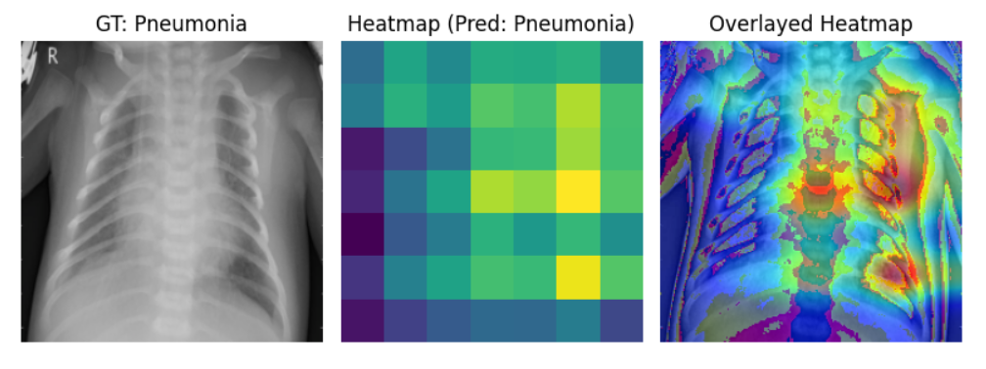
Results & Interpretation
Normal Images
Pneumonia Images

Slide 8
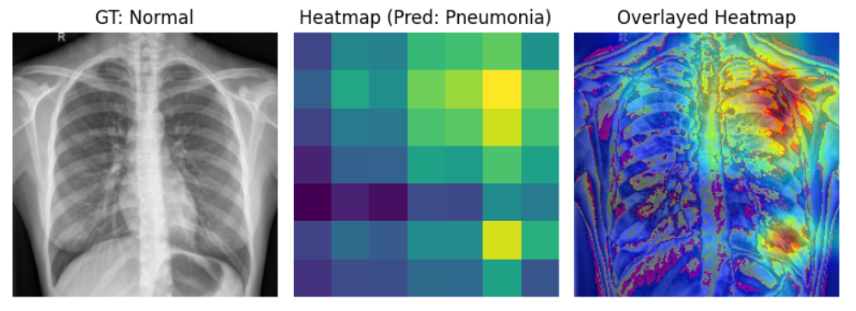
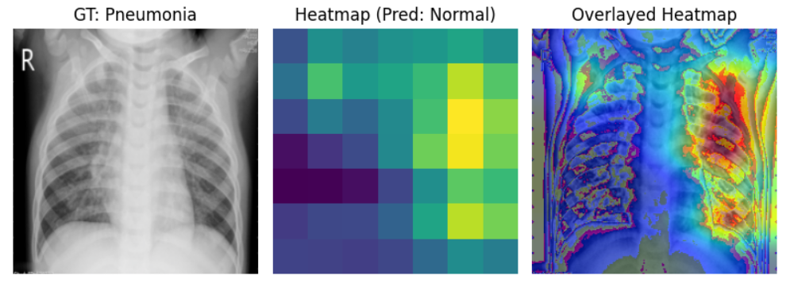
Cases when model failed

Slide 9
Future Work
The model doesn't show exactly where pneumonia is. Adding semantic segmentation could fix this, making our diagnosis even better.
We can explore using semantic segmentation to find exactly where pneumonia is in the image. This helps doctors pinpoint the problem area more accurately.

Slide 10
Thank you

